Slide 1

EDUCATION OPPORTUNITIES
IN
DIGITAL WORLD
INSTRUCTIONAL
MEDIA
CENTRE

Slide 2


Slide 3

MANTRA FOR SUCCESS
DISCIPLINE
GATHERING
INFORMATION/
KNOWLEDGE
EDUCATION
REPRODUCING
INFORMATION/
KNOWLEDGE

Slide 4

DIGITAL WORLD
INFORMATION AGE

Slide 5






UNDERSTANDING
INFORMATION FLOW
World Wide Web

Slide 6

?
HOW TO UTILISE THESE DIGITAL RESOURCES
FOR EDUCATION
INFORMATION FLOW

Slide 7

Government of India’s Digital Initiatives in Education
To democratise the opportunities of quality education, the Government launched the National Mission on Education through ICT (NMEICT) to translate the power of IT into expanded learning opportunities.
Large scale expansion of the high quality education opportunities and the Digital Technology can be leveraged to address these twin concerns of enhancing access and quality.

Slide 8



Slide 9
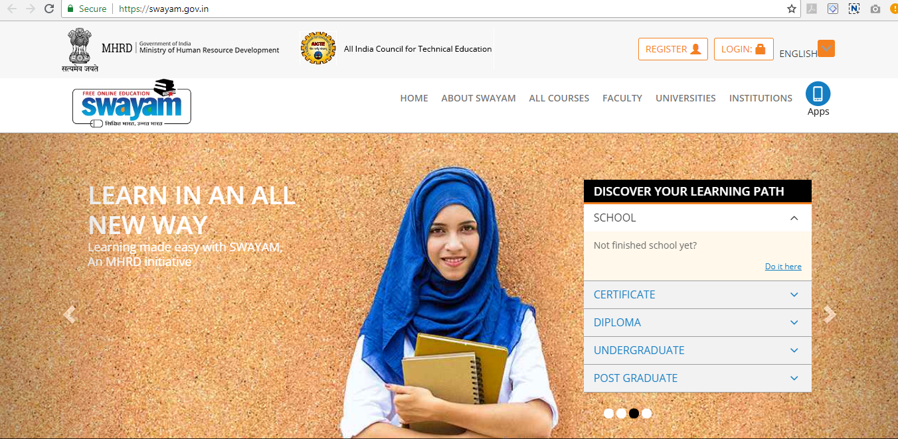
https://swayam.gov.in/

Slide 10
IT platform that facilitates hosting of all the courses.
Taught in classrooms from 9th class till post-graduation.
To be accessed by anyone, anywhere at any time.
All the courses are interactive, prepared by the best teachers in the country.
Available free of cost to the residents in India.
More than 1,000 specially chosen faculty and teachers from across the Country have participated in preparing these courses.

Slide 11
A/V

Slide 12
UNDERSTANDING
SWAYAM
Courses delivered through SWAYAM are available free of cost to the learners.
It is designed to achieve the three cardinal principles of Education Policy that are
ACCESS
EQUITY
QUALITY
However, students wanting certifications shall be registered, shall be offered a certificate on successful completion of the course, with a little fee
The objective of this effort is to take the best teaching learning resources to all, including the most disadvantaged.

Slide 13
THE FOUR QUADRANT APPROACH
VIDEO LECTURE
SPECIALLY PREPARED STUDY MATERIAL THAT CAN BE DOWNLOADED
SELF - ASSESSMENT TESTS
ONLINE DISCUSSION FORUM FOR CLEARING DOUBTS

Slide 14
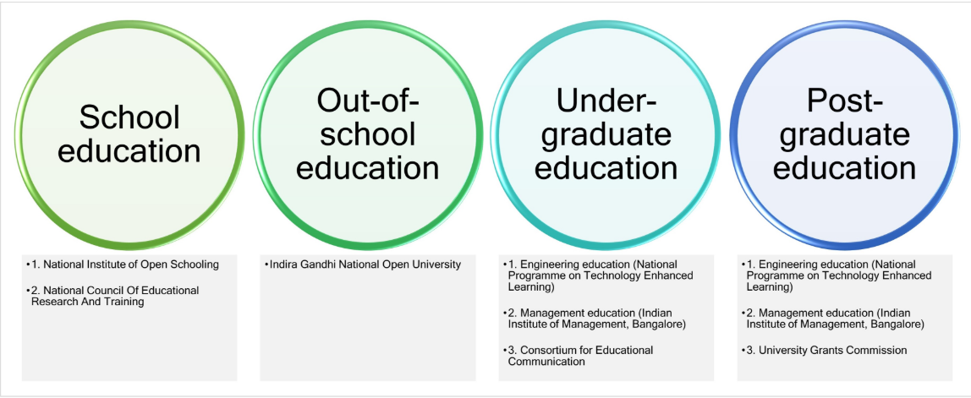
SWAYAM
NATIONAL COORDINATORS
NPTEL For engineering
UGC
For Post-Graduation Courses
AICTE For self-paced courses
CEC
For Undergraduate Courses
NCERT & NIOS
For Schools Education
IGNOU
For Out of School Students
IIMB For Management Studies

Slide 15
The SWAYAM PRABHA is a group of 32 DTH channels devoted to telecasting of high-quality educational programmes (Video Lectures) on 24X7 basis using the GSAT-15 satellite.
The contents are provided by NPTEL, IITs, UGC, CEC, IGNOU, NCERT and NIOS.

Slide 16
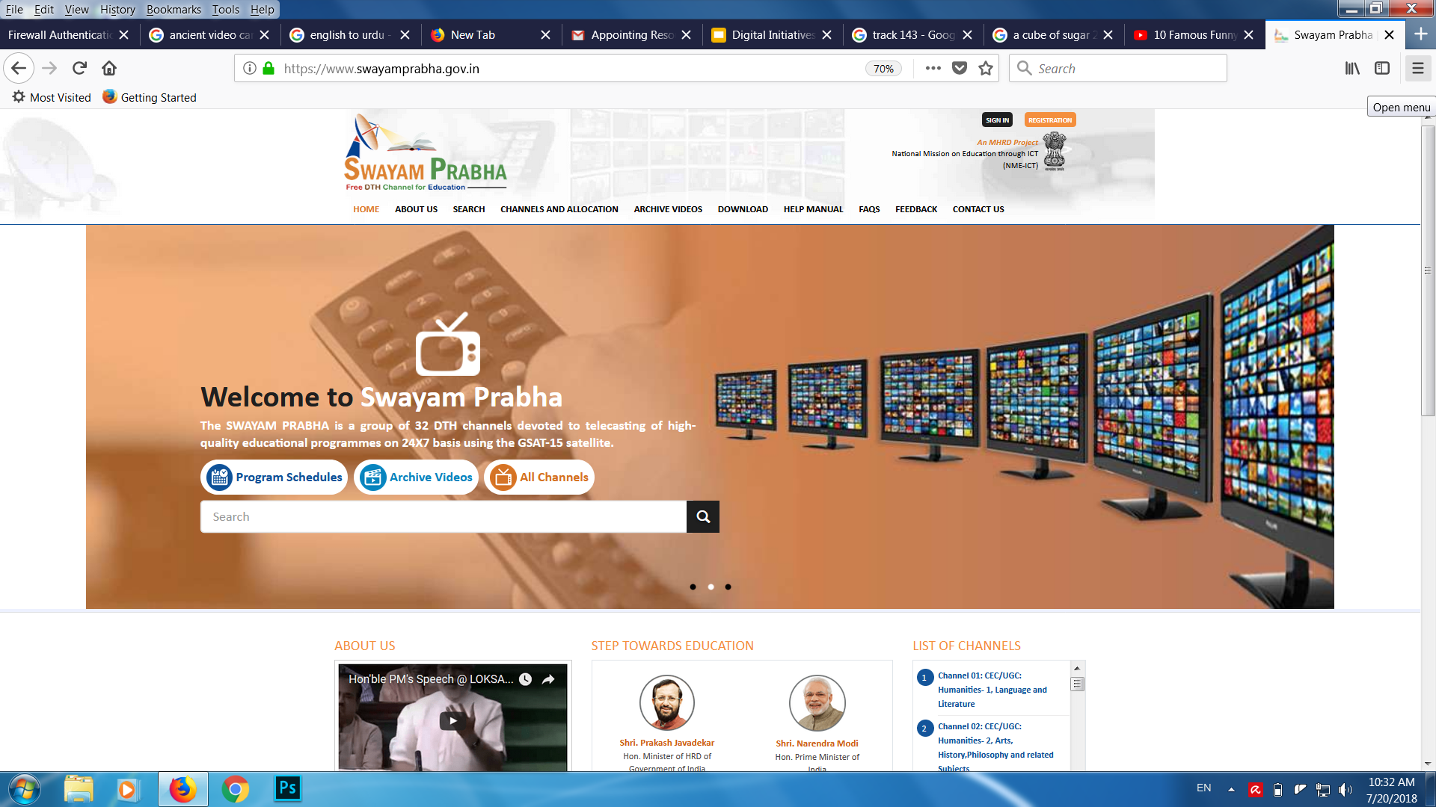
https://www.swayamprabha.gov.in/

Slide 17
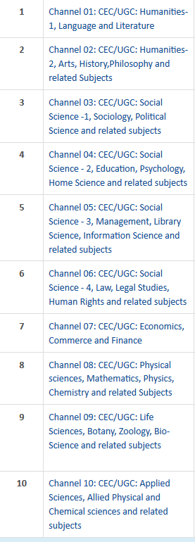
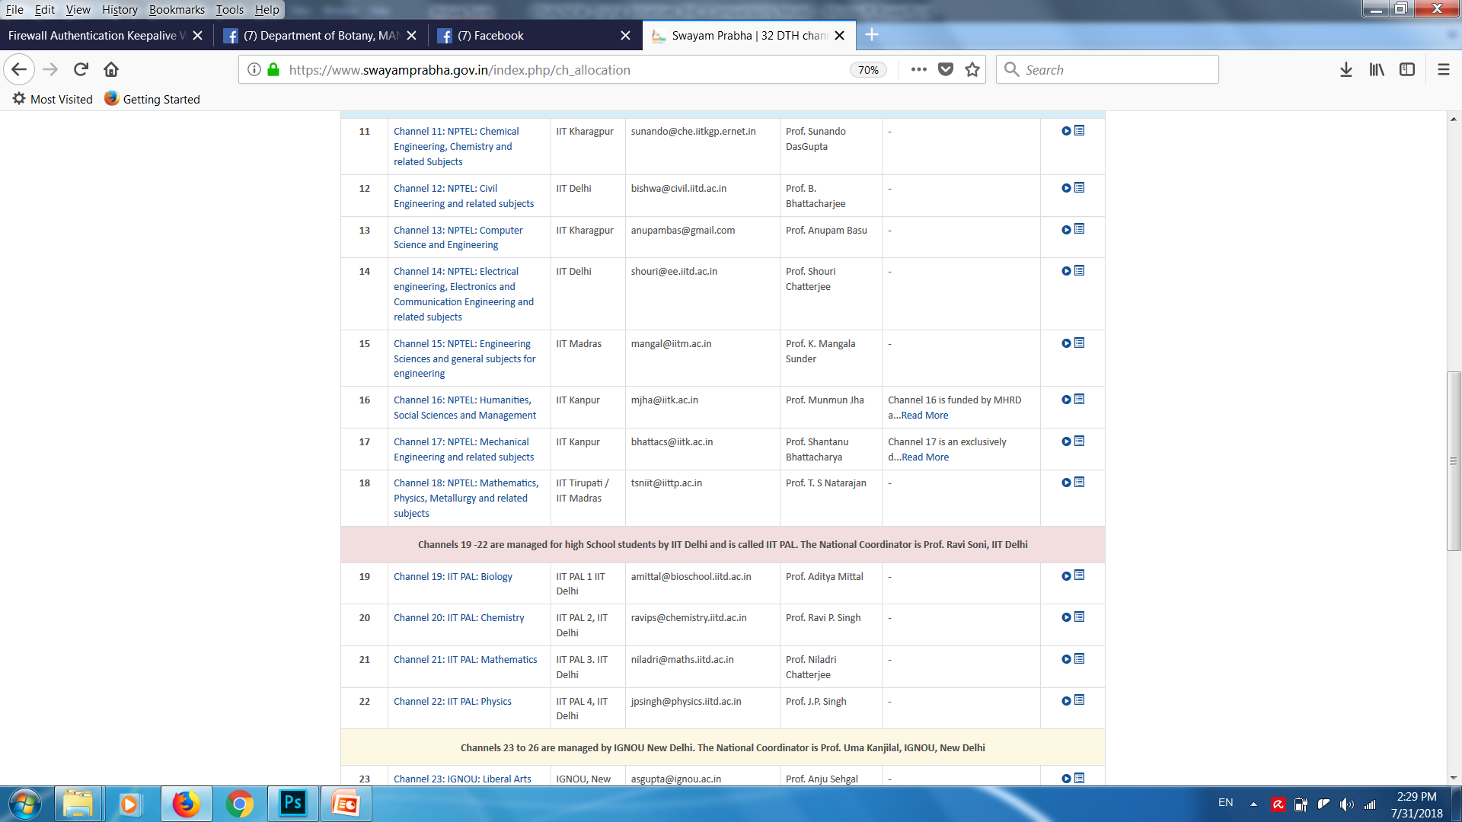
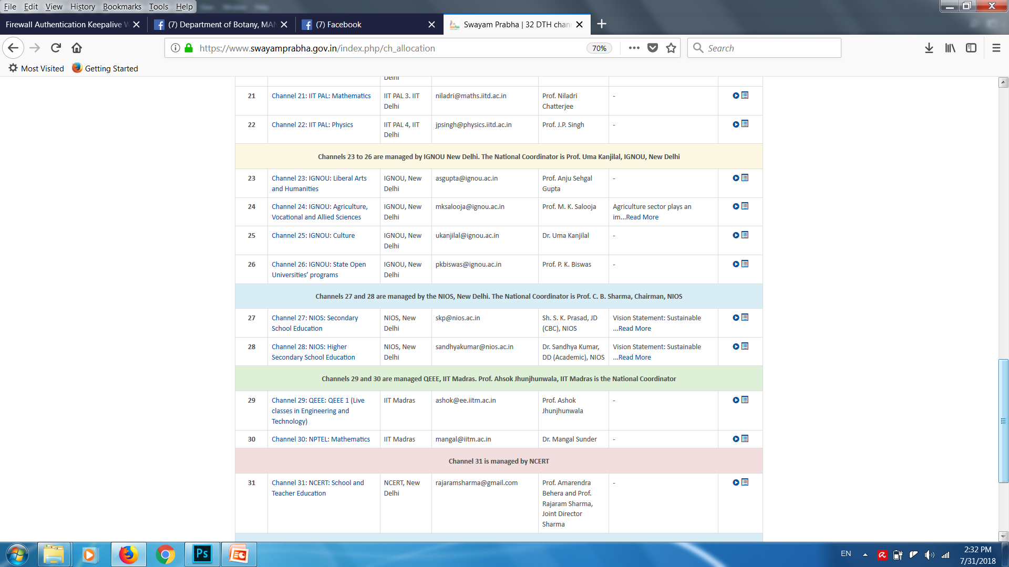
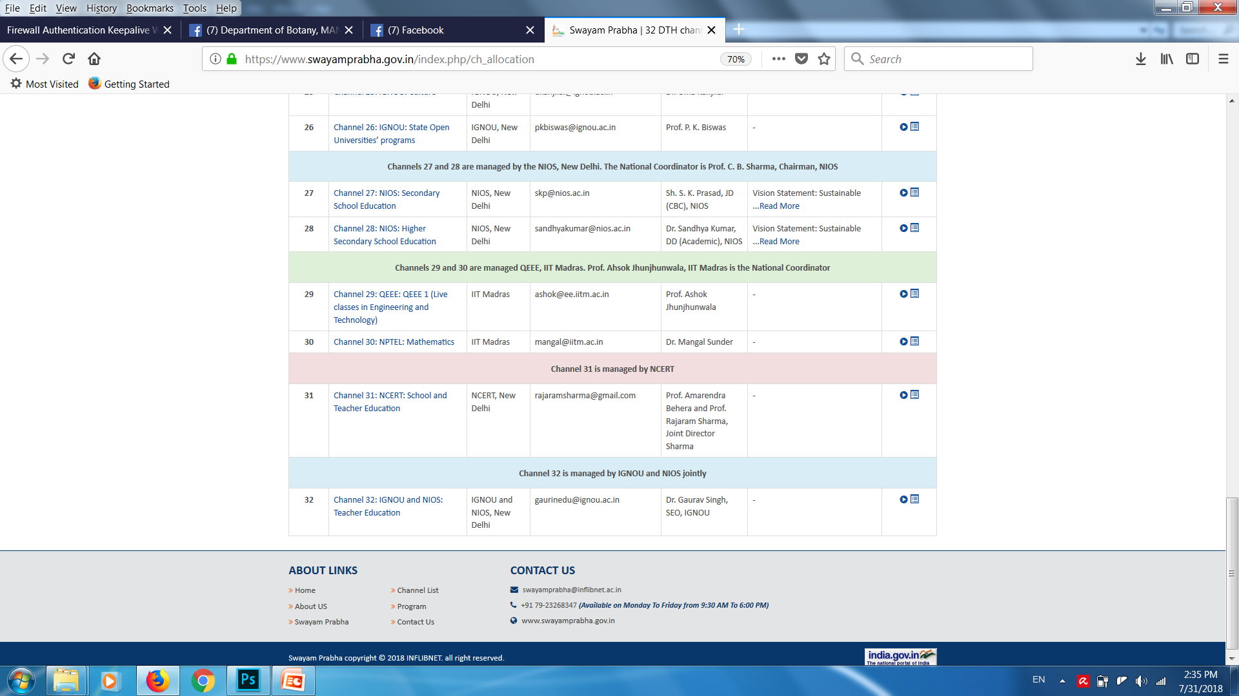
LIST OF SWAYAM PRABHA
CHANNELS

Slide 18
THE HOW AND WHEN OF
SWAYAM
PRABHA
4
EVERY DAY NEW CONTENT FOR
HOURS
STUDENTS CAN CHOOSE THEIR TIME OF CONVENIENCE
YOUTUBE/WEBPORTAL/DTH at IMC

Slide 19
CONTENT ON THE D2H CHANNELS COVERS
SCHOOL EDUCATION
LEVEL 09 - 12
HIGHER EDUCATION
CURRICULUM BASED COURSES
THAT MEET THE NEEDS OF GENERAL AUDIENCES
ASSIST STUDENTS (LEVEL 11 & 12)
IN PREPARATION FOR COMPETITIVE EXAMS

Slide 20
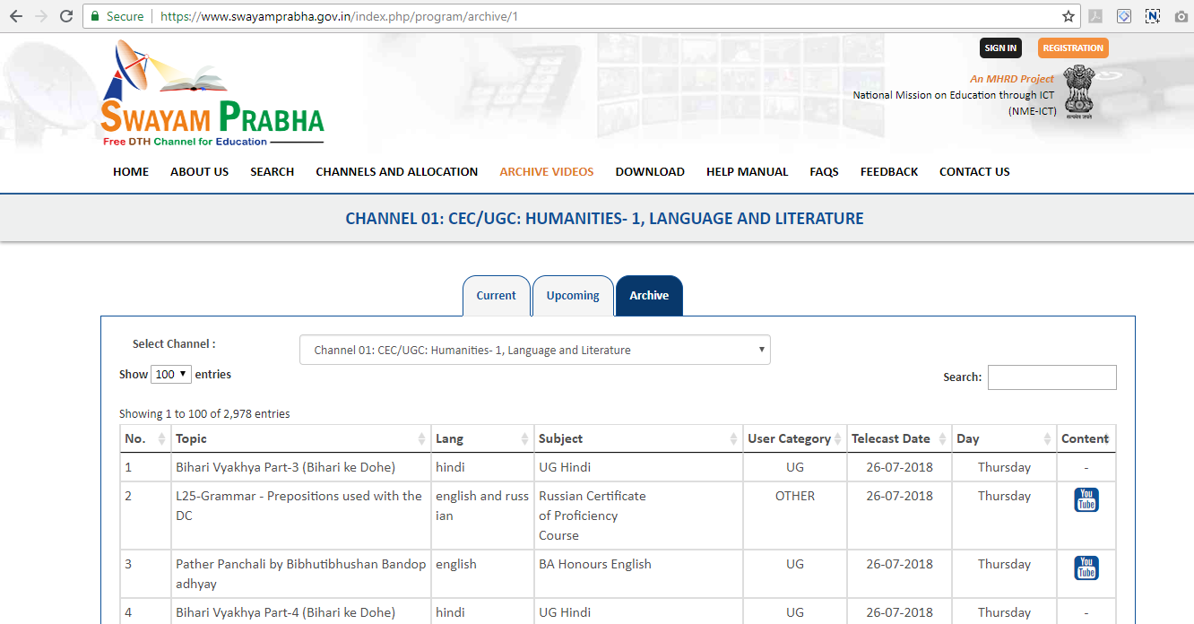

Scroll and search a topic of your choice to study from a heavy database that the Swayam Prabha offers.

Slide 21



Slide 22
Converting
Social Media into EDUCATIONAL
MEDIA

Slide 24
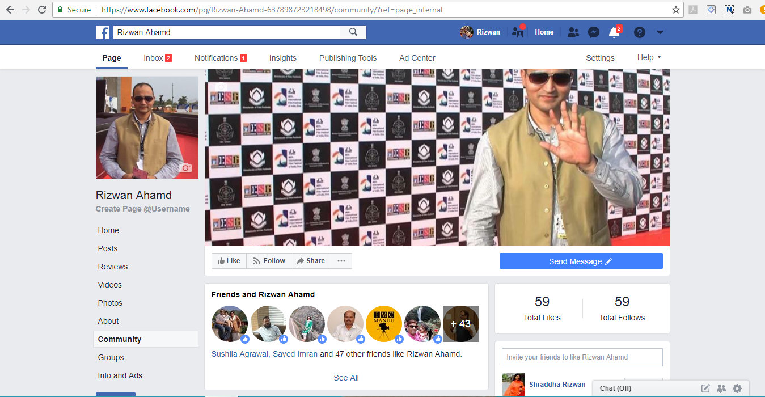

Slide 25
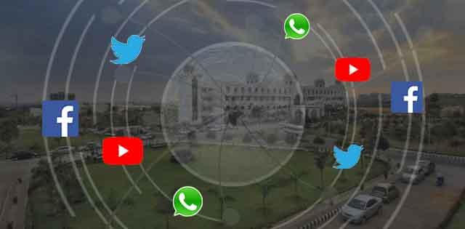
TAKING EDUCATION
TO THE GLOBAL MAP
GLOBAL ACADEMIC COMMUNITY ?

Slide 26
?
HOW
DO WE DO THAT

Slide 27
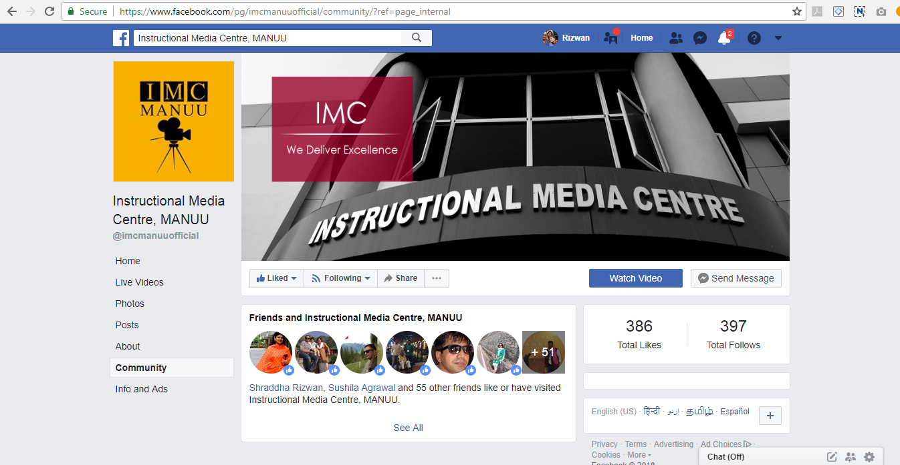

Slide 28
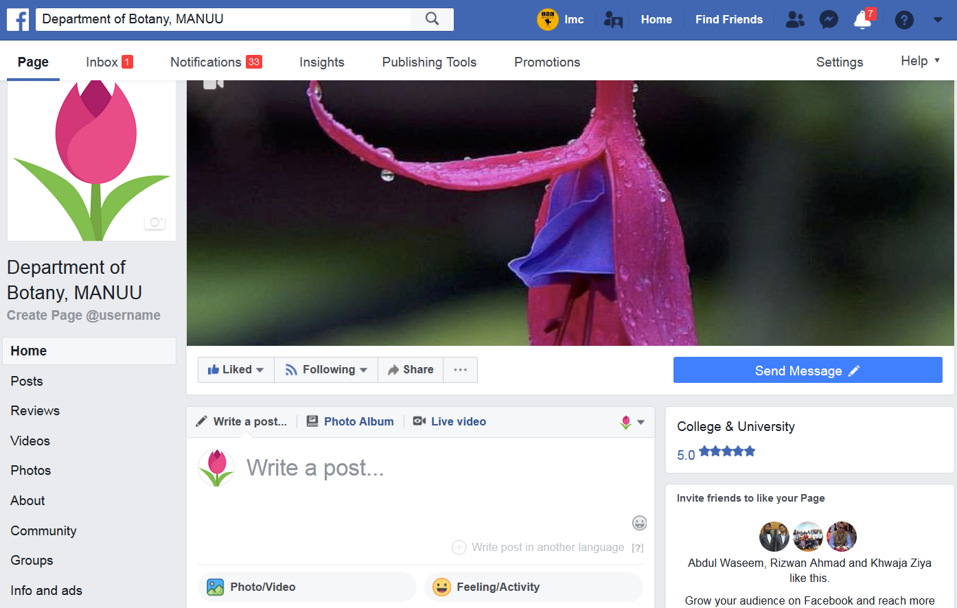
GLOBAL OUTREACH

Slide 29
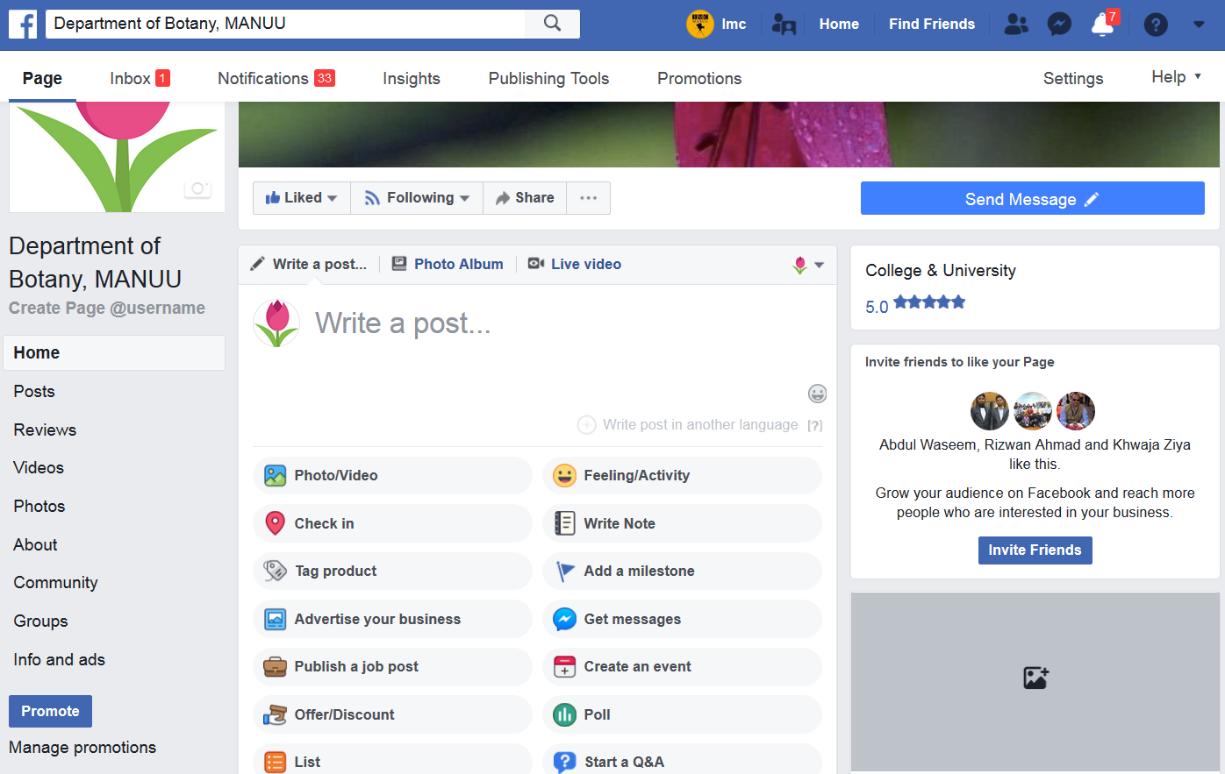
SHARING RESOURCES

Slide 30
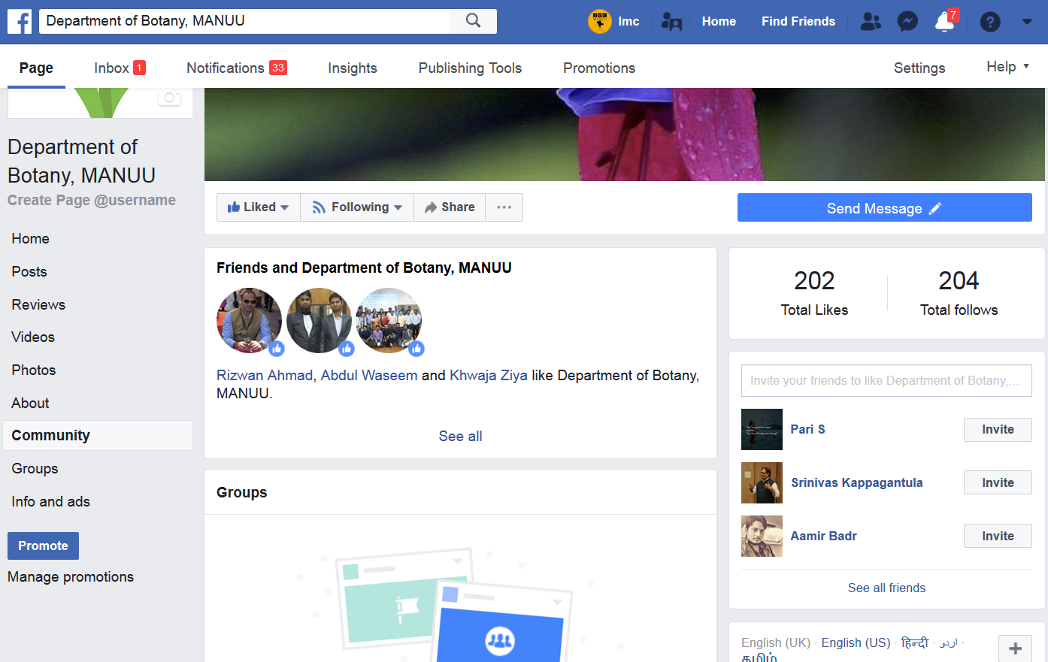
BUILDING A GLOBAL
ACADEMIC COMMUNITY

Slide 31
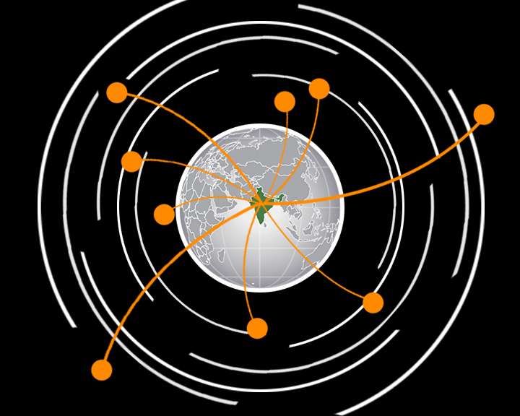

CONNECTING WORLDWIDE
In these rapidly changing times in technology, we need to ADJUST AND ADAPT quickly.
EXCHANGE AND EXPOSURE
Exchange of information should not be limited in any context.
Hence, we should always look ahead and try making ties within the country and across the globe.
Connecting with the best resource person in their respective field gives perspective to the students knowledge and information.

Slide 32

EXCHANGE PROGRAM
STUDENTS
EXPERTS
EXPERTS
STUDENTS

Slide 33
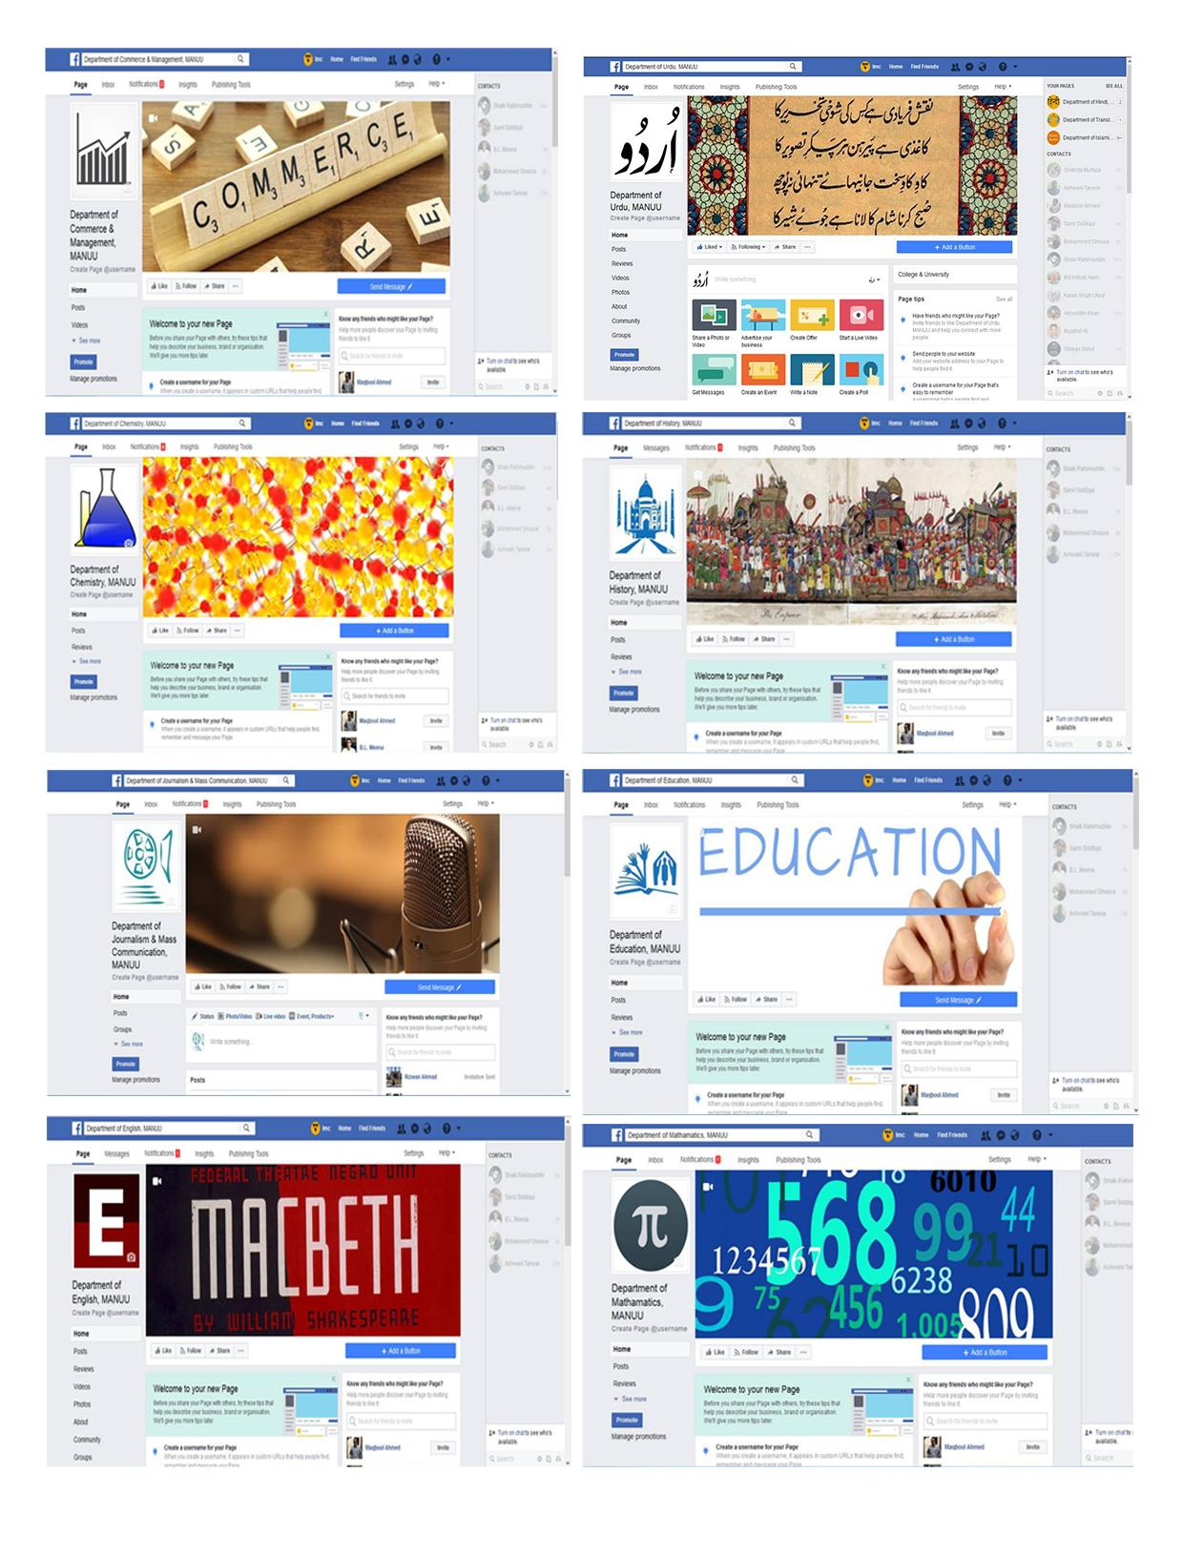
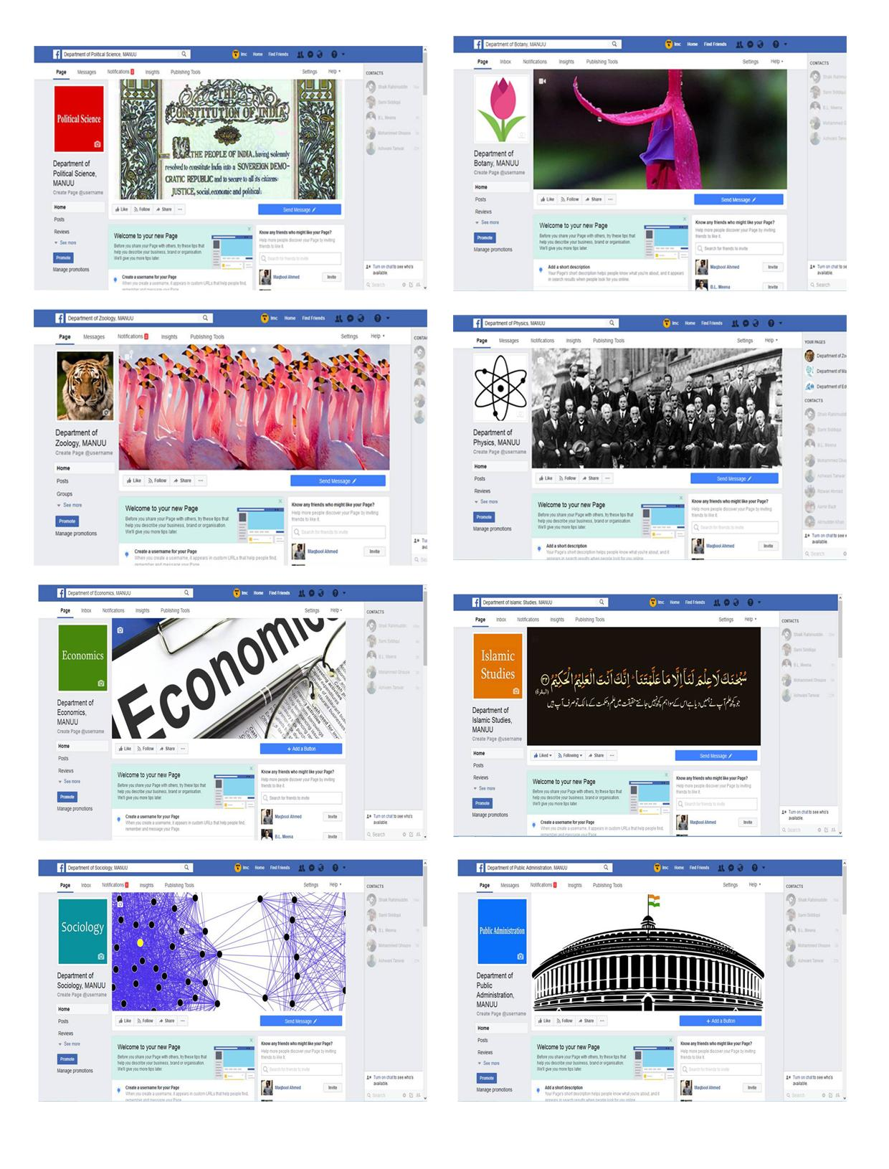
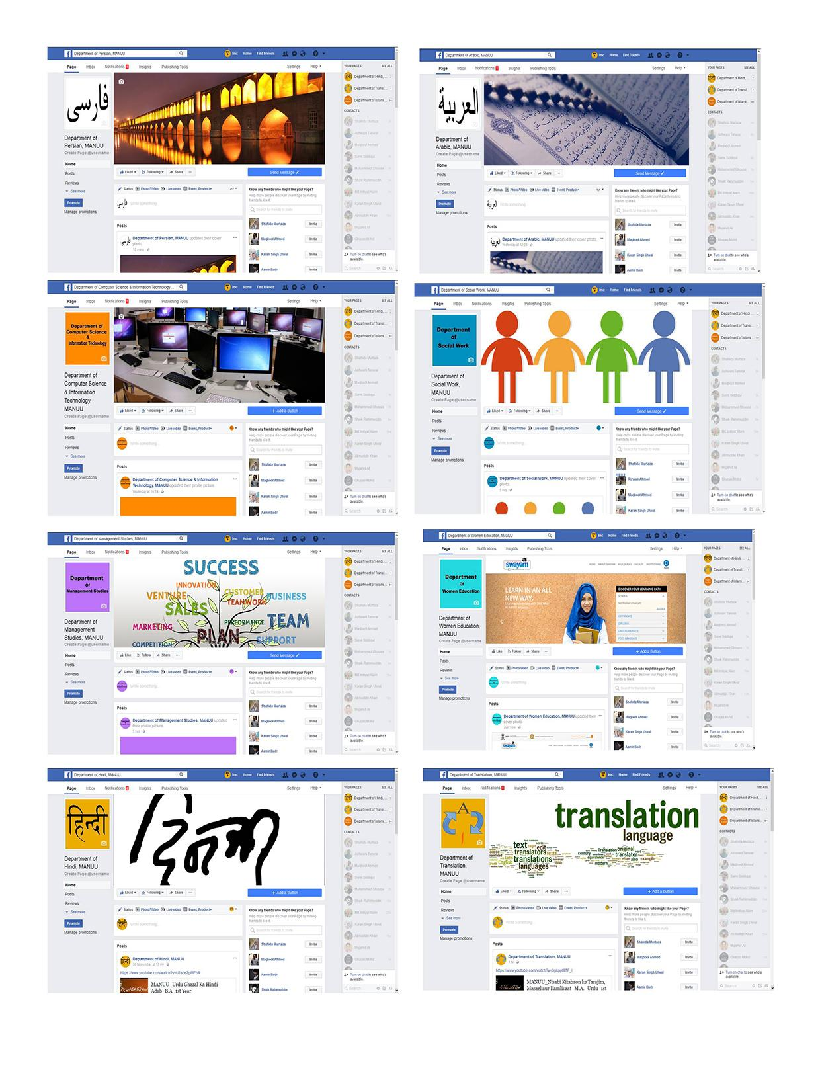
FACEBOOK
IMC has created Facebook pages for every department in the University

Slide 35
BEST TOOLS
TO SHARE
PRE-CLASS/POST-CLASS RESOURCES, DEPARTMENT ACTIVITIES

Slide 36
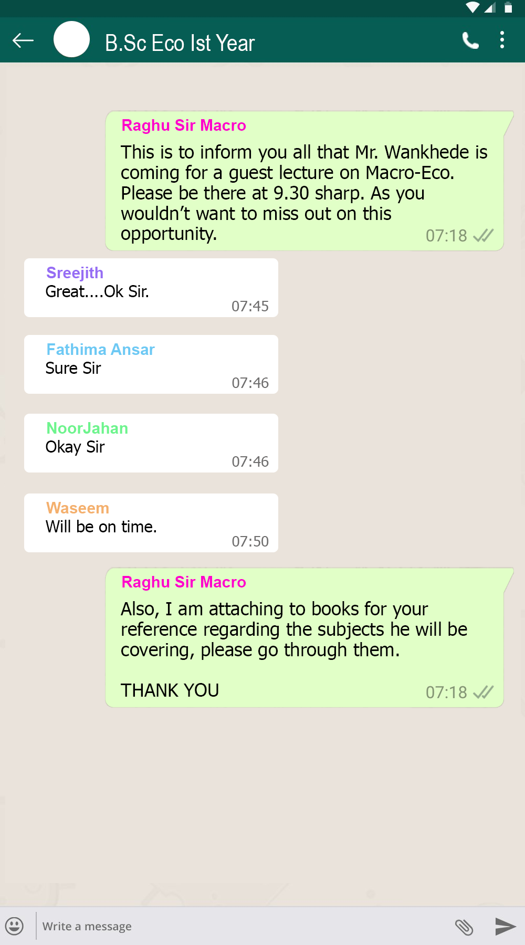
Activity
VERTICAL GROUPS
The creation of vertical groups every year should be done extensively.
Whatsapp is used for all sorts of exchange of communication.
Why not use it for the purpose of education.
Groups can be created for official exchange of information between the faculty and education.
Doubts and queries can be cleared.
Intimidations regarding a guest lecture, seminar or a field visit can be made to the students who can further coordinate accordingly.
Faculties can and should take this as official communication with their students which in-turn makes them more approachable to the students.

Slide 37
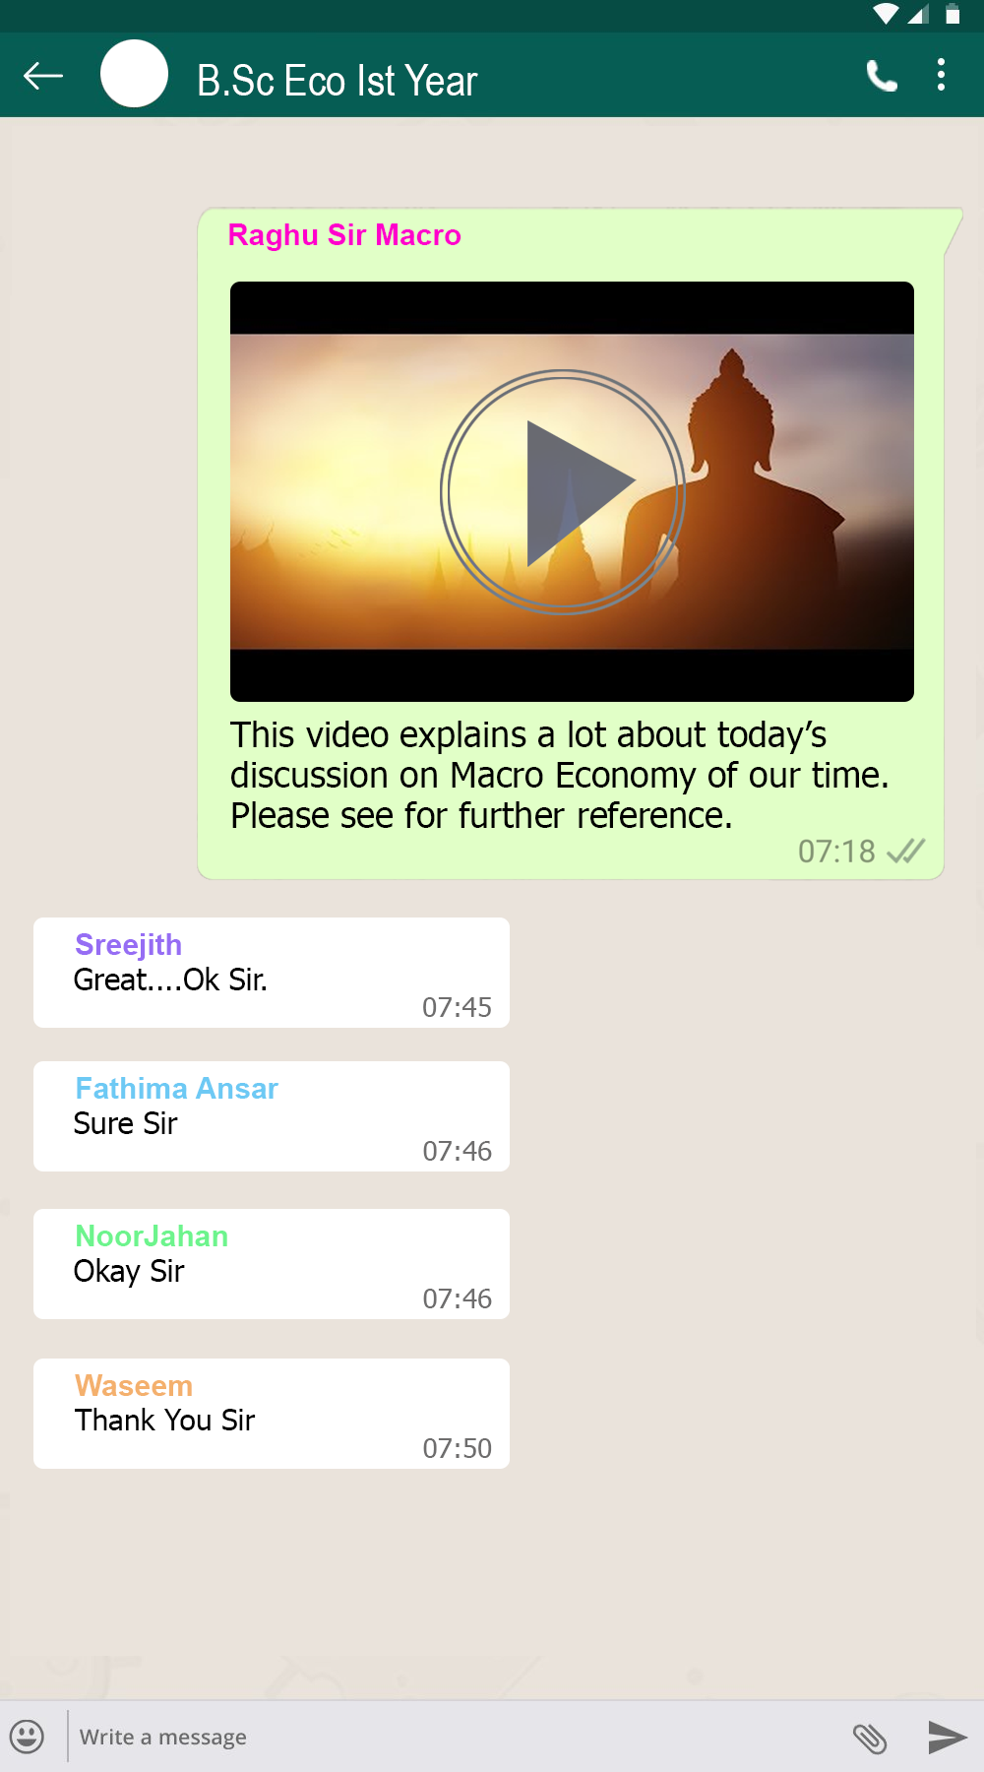
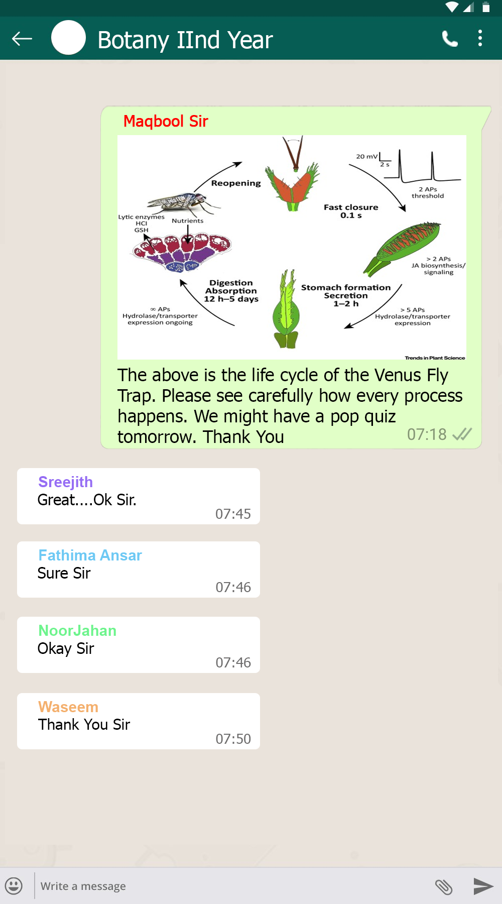
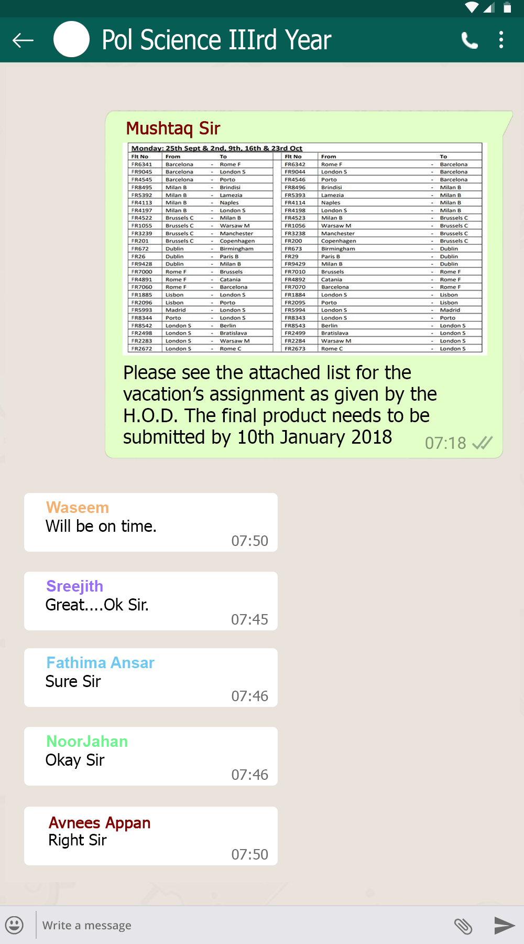

Slide 38
The Aim is to build and serve a Knowledge Society.

Slide 39
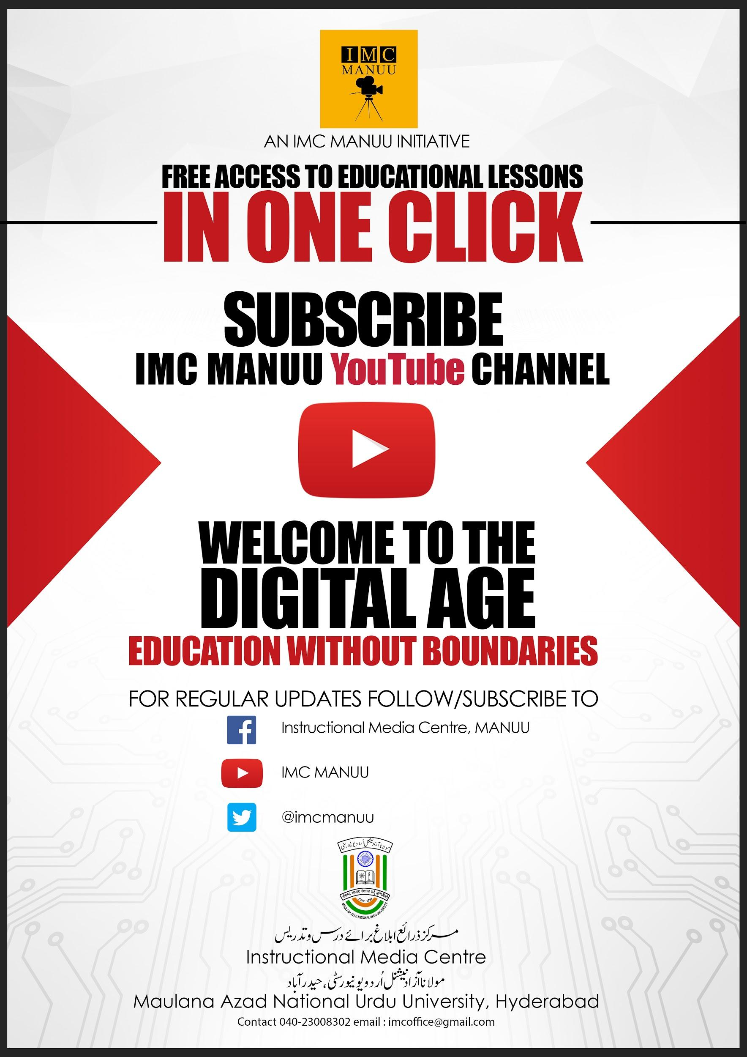

IMC Manuu YouTube Channel
LAUNCH
To provide the wider access of Higher Education, Instructional Media Centre created IMC MANUU Youtube channel which has a repository of curriculum based audio-visual programmes of various streams like Science, Social Science, Life Science, Education and Training, Arts and Languages etc. and these are available to masses free of cost all across the globe.

Slide 40
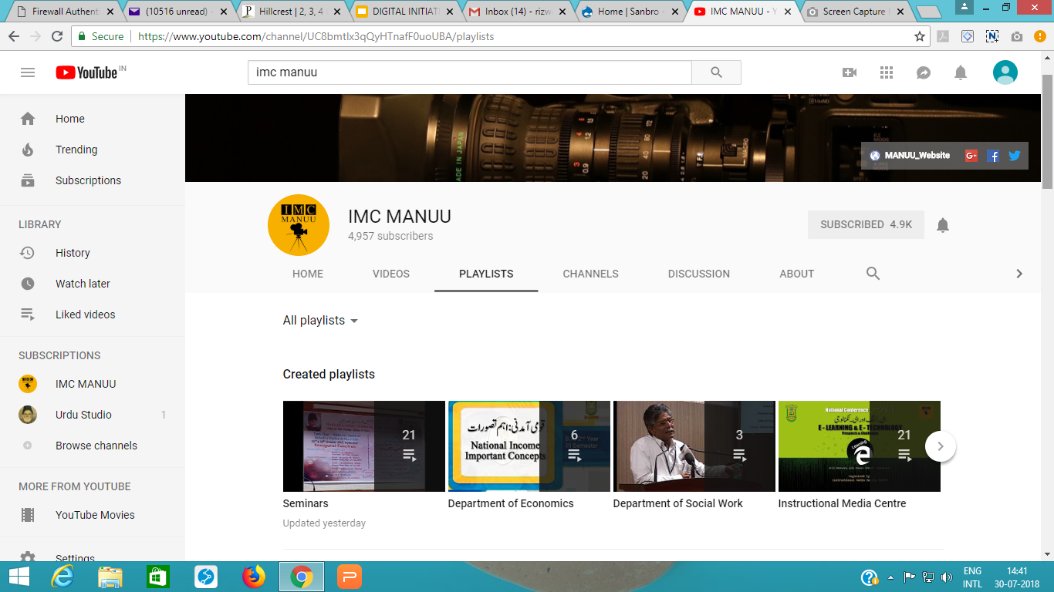

Slide 41
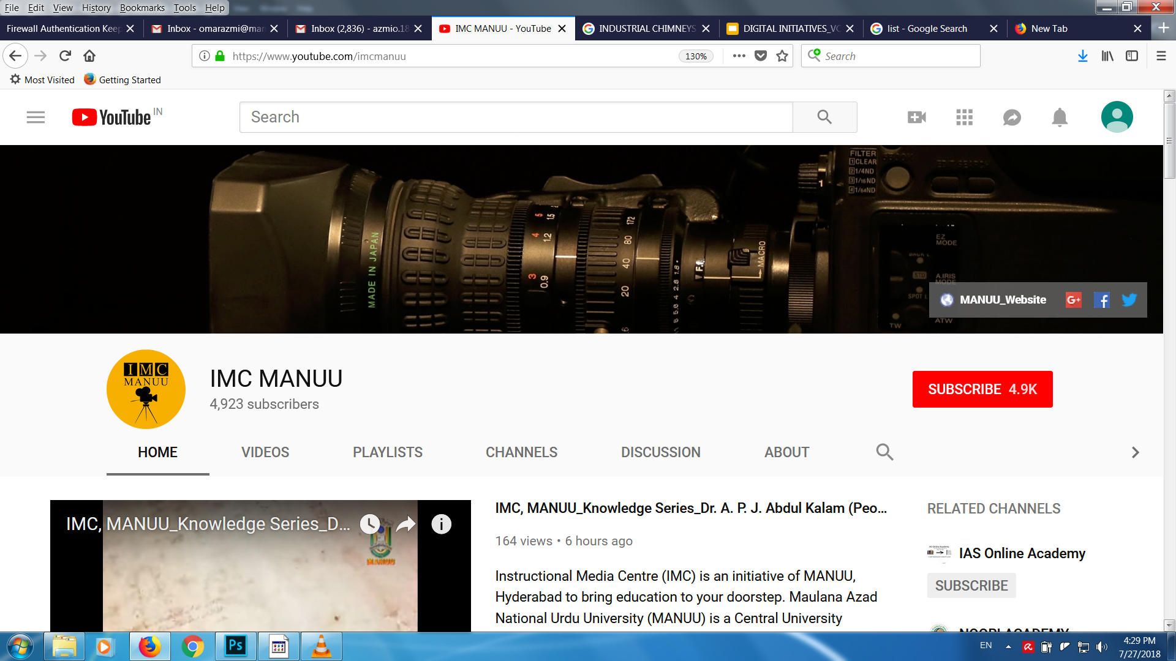
GO TO THE LINK https://www.youtube.com/imcmanuu

Slide 42

INFORMATION IS POWER
And the powerful withholds information

Slide 43
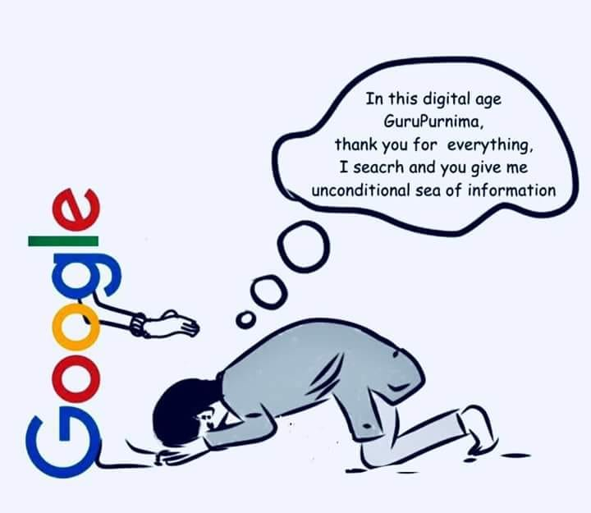

Slide 44
THANK YOU

